Slide 1
TRI Update
Brenden Eum
Apr 10, 2025

Slide 2
github.com/BrendenEum/motorVAE

Slide 3
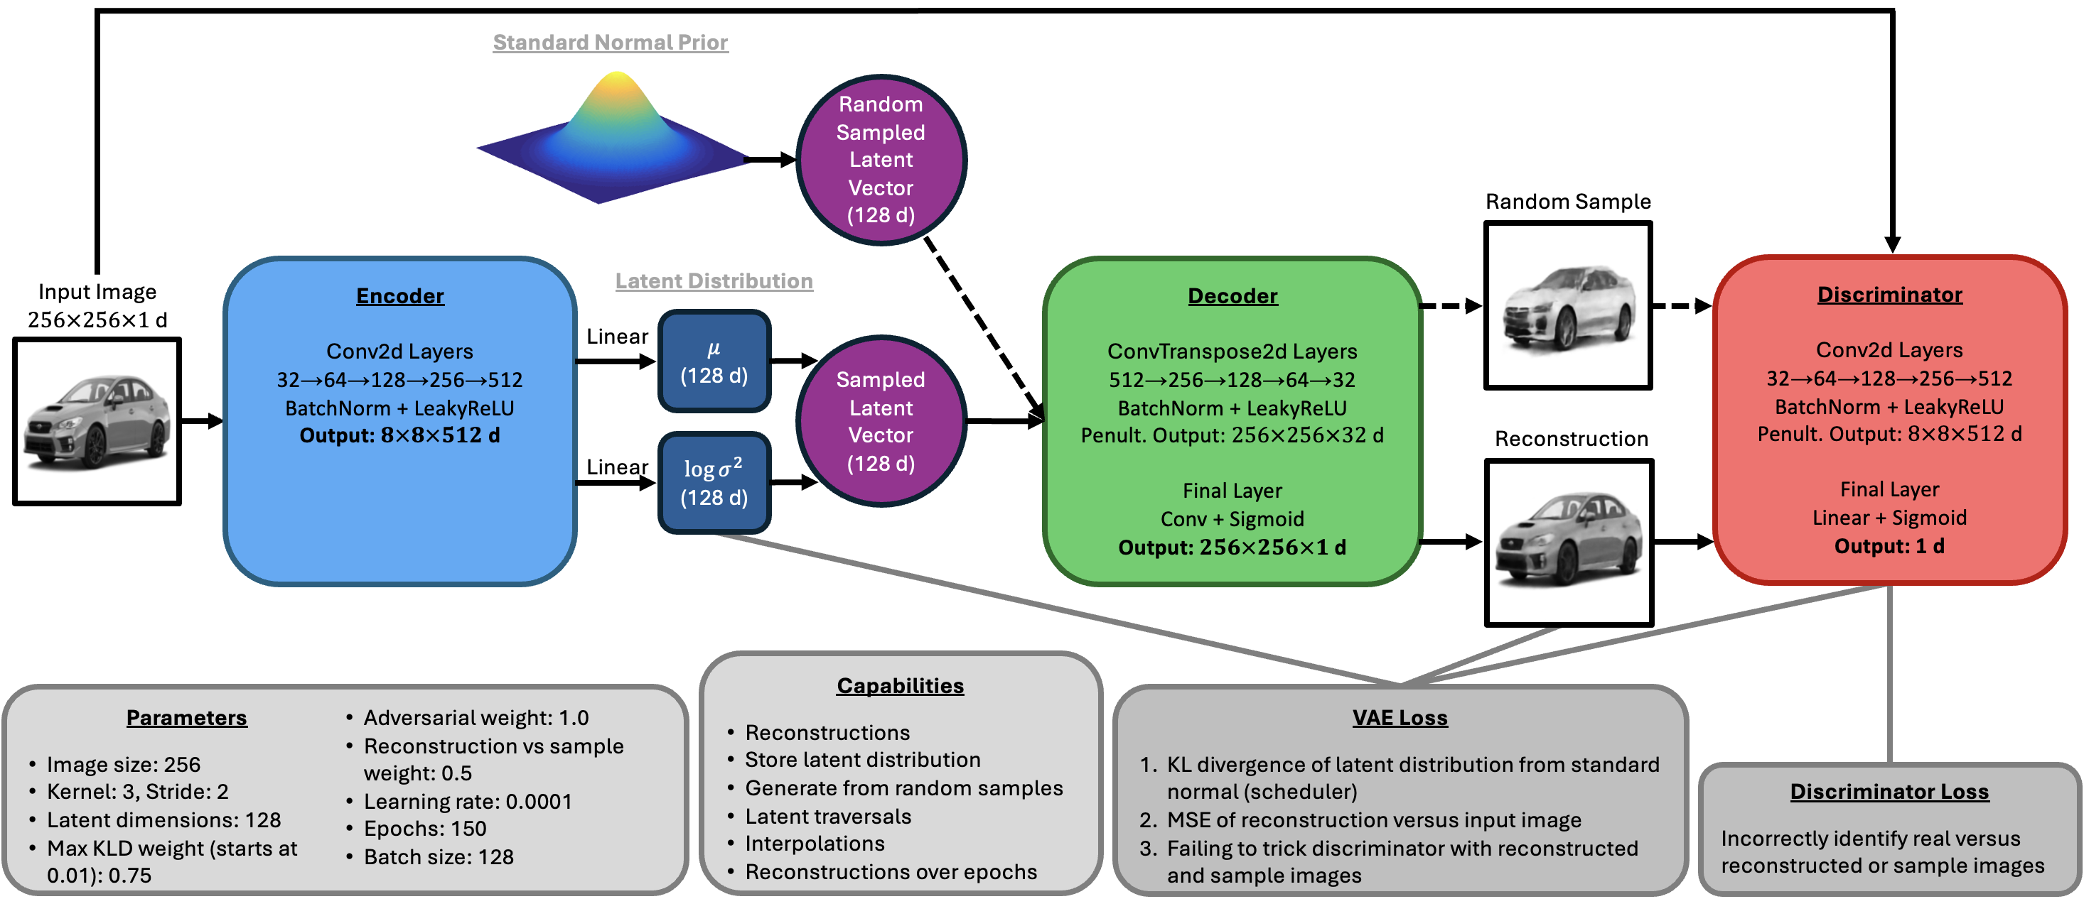

Slide 4
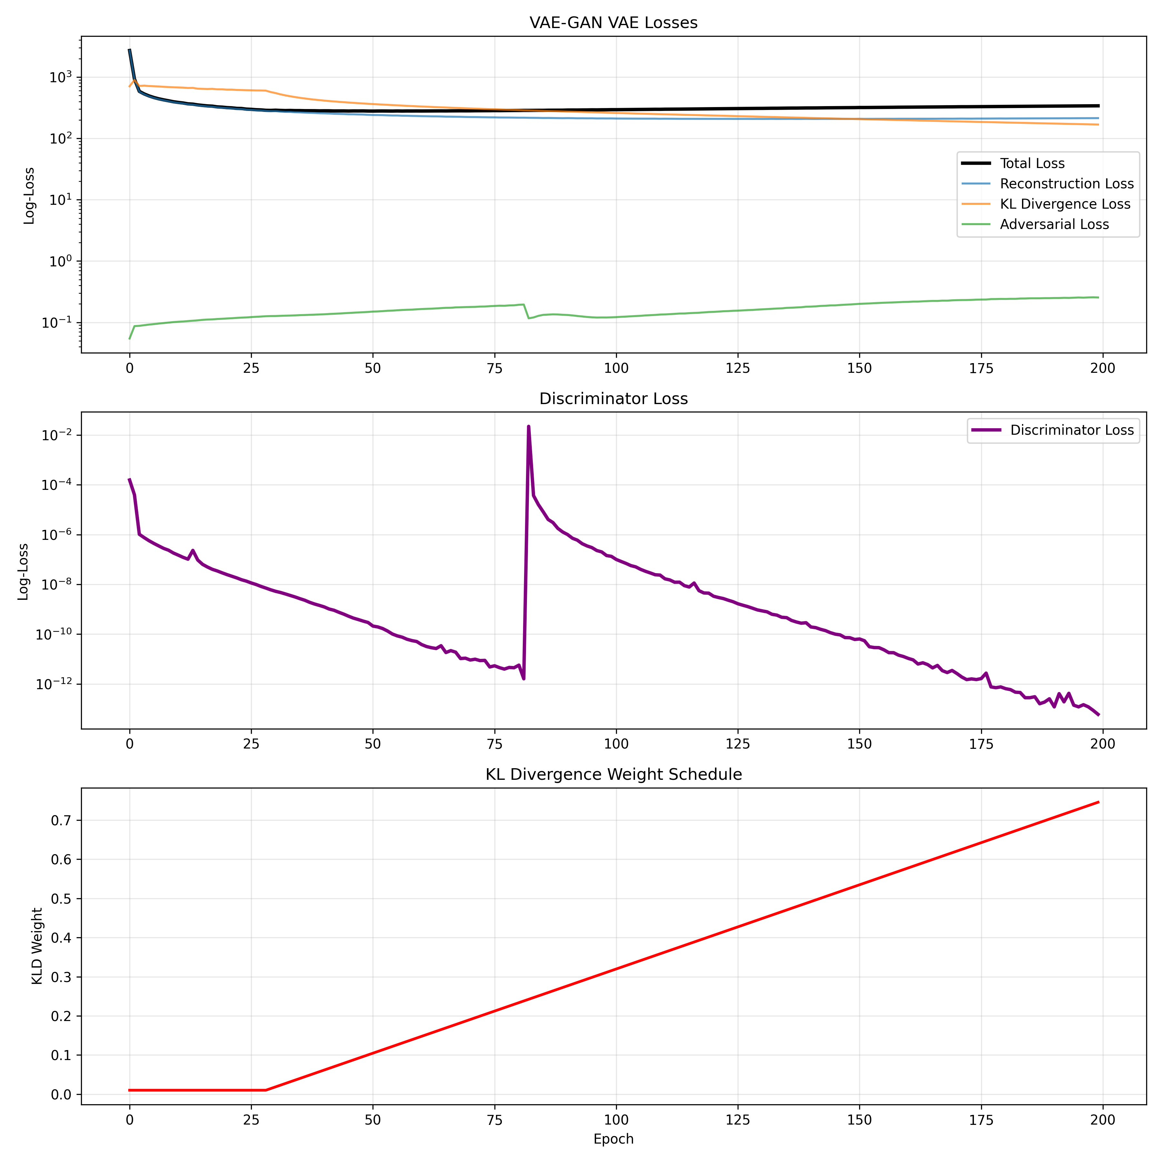
Focus on latent space structure
Focus on reconstruction quality

Slide 5
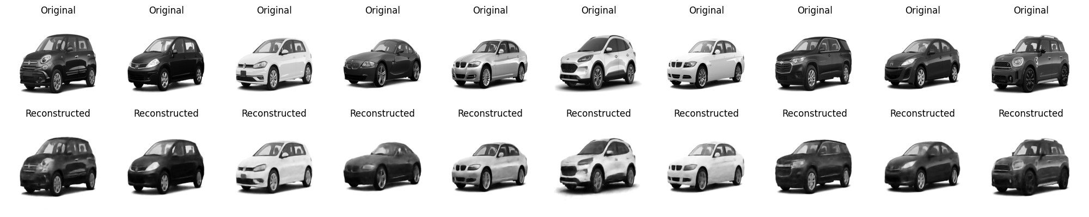
motorVAEGAN_res256_lat128_epo200_bat128_lrn0.0001_kld0.75_adv1.0_rec0.5

Slide 6
motorVAEGAN_res256_lat128_epo200_bat128_lrn0.0001_kld0.75_adv1.0_rec0.5
?

Slide 7
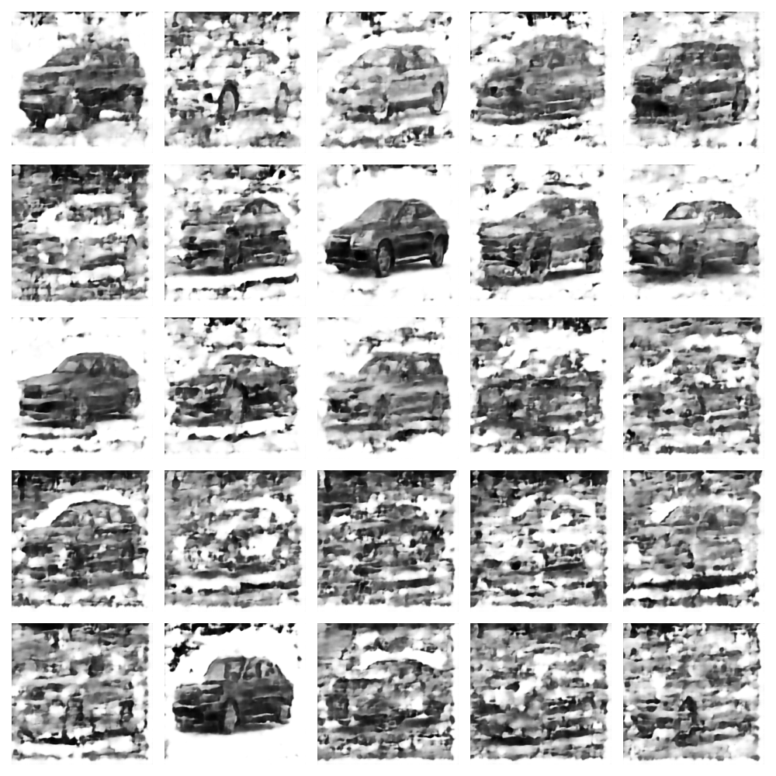
KLD weight schedule from 0.01 to 0.75 improves sample quality by gradually imposing latent structure.
Before schedule (w_kld = 0.5)

Slide 8
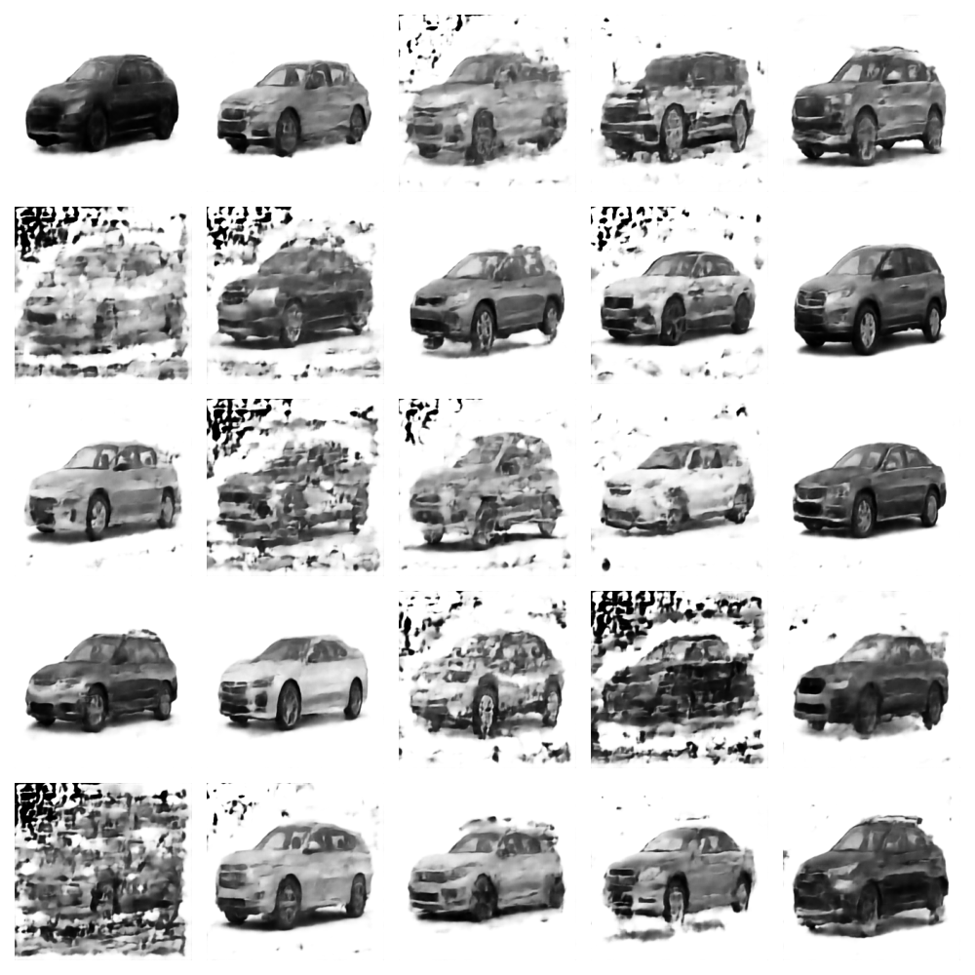
KLD weight schedule from 0.01 to 0.75 improves sample quality by gradually imposing latent structure.
Before schedule (w_kld = 0.5)
After schedule

Slide 9
Reconstruction quality over epochs

Slide 10
Reconstruction quality over epochs (with various max epochs)

Slide 11
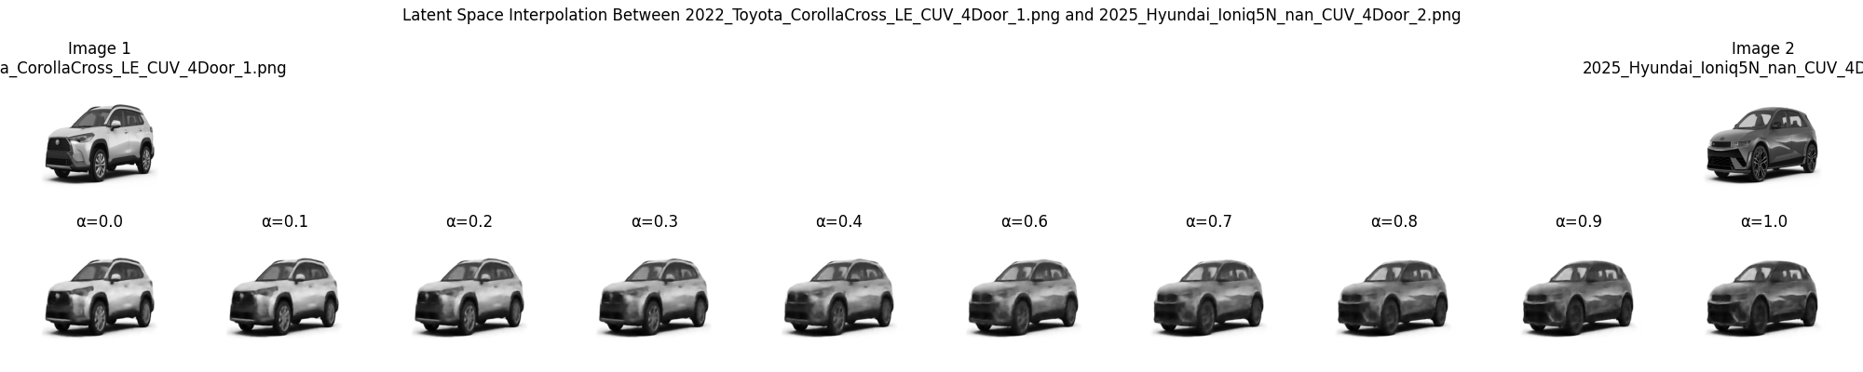
Interpolate between two cars

Slide 12
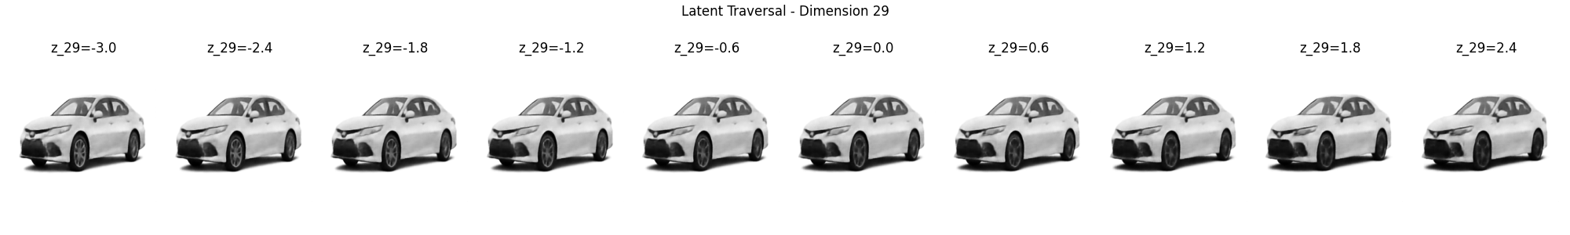
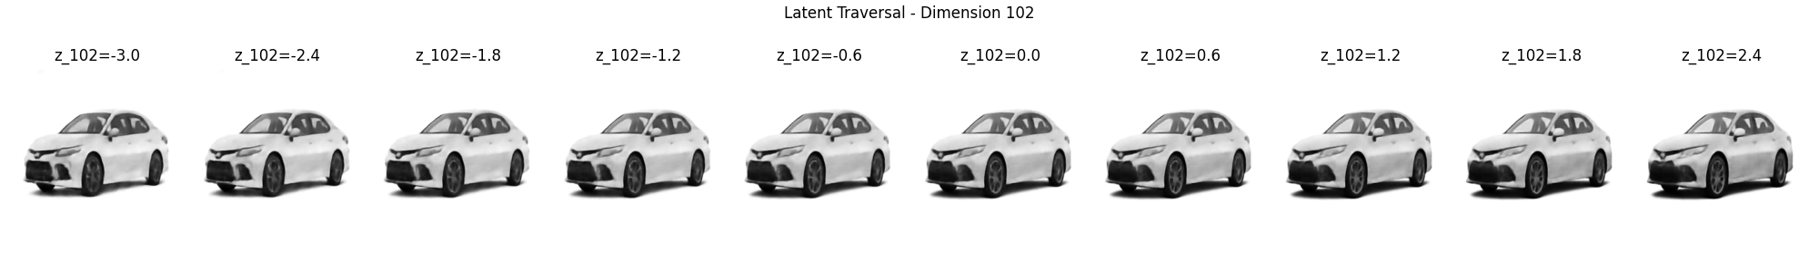
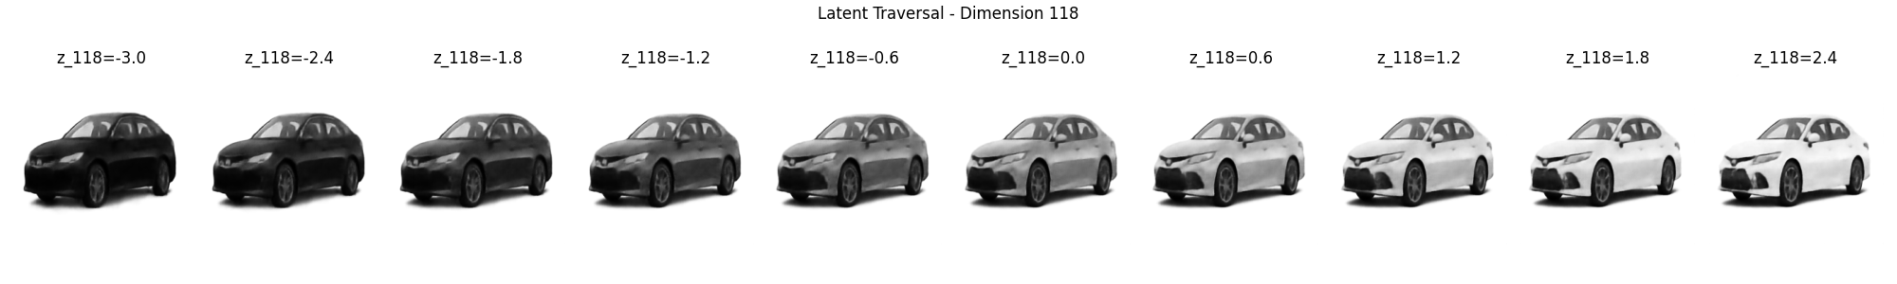
Examples of latent space traversals
“shape of fog lights”
“separation of grill and fog lights”
“color”

Slide 13
Examples of latent space traversals
“shape of fog lights”
Cherry-picked. Still a lot of entangled features.
“separation of grill and fog lights”
“color”

Slide 14
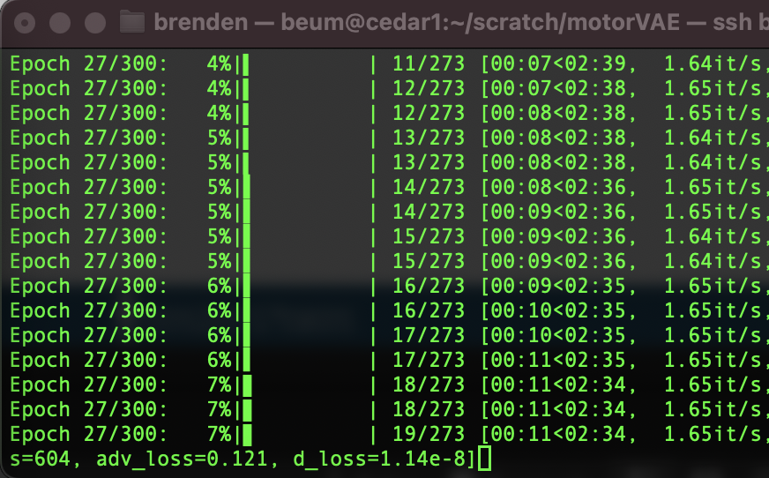
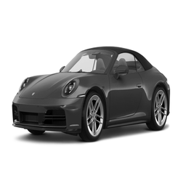
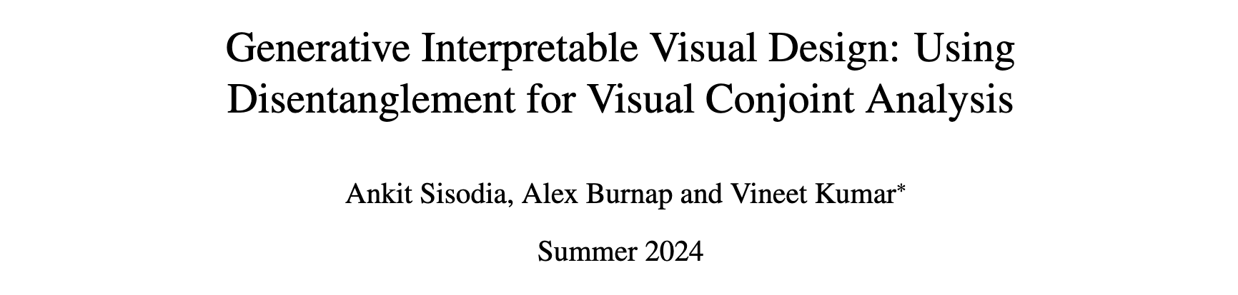
Next Steps
Increase the number of epochs to 300+
Other benchmarks (Style-GAN, ALAE)
CelebA dataset 100-200 epochs
FFHQ dataset 200-300+ epochs
Add white bars to images to maintain original aspect ratio.
Introduce supervised network for characteristic classification (Sisodia et al 2024). Should improve disentanglement.

